Slide 1
Behavioural & Experimental Economics Choice under Certainty
Lunzheng Li
University of Cyprus

Slide 2
Course Outline
Choice under Certainty
Judgement under Risk & Uncertainty
Choices under Risk & Uncertainty
Intertemporal Choice
Strategic Interaction

Slide 3
Course Outline
Choice under Certainty
Rational Choice under Certainty
Decision-making under Certainty
Judgement under Risk & Uncertainty
Choices under Risk & Uncertainty
Intertemporal Choice
Strategic Interaction

Slide 4
Choice under Certainty
…under certainty:
There is no doubt as to which outcome will result from a given act.
For example, the university’s coffee shop you know exactly what you will get if you order a ‘freddo espresso’ or a ‘hot americano’.
If you book a weekend at a beach hotel in Pafos for the end of October, there is uncertainty because you cannot know for sure how the weather will be, and therefore you do not know how much you will enjoy that weekend.
We will look at choice under uncertainty later in the course.

Slide 5
Rational Choice under Certainty
A theory with two main elements:
Preferences: what does a person like.
Menus/budget sets: what can a person choose from.
The theory makes assumptions about preferences and how a person makes a choices from the available alternatives given their preferences.

Slide 6
Preference
The concept of preference is fundamental in modern economics, neoclassical and behavioral.
Formally speaking, a preference is a relation.

Slide 7
Binary relations
Examples
France is bigger than Norway
Alf is older than Betsy
Anne is a friend of Bob

Slide 8
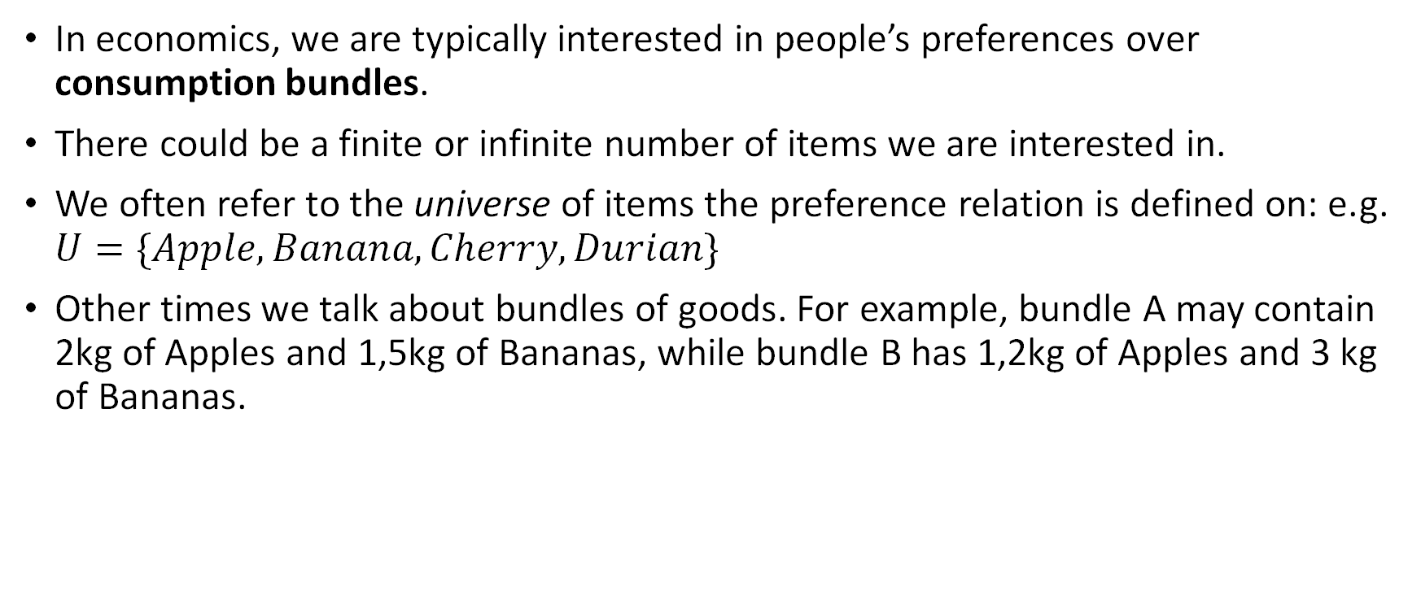
Preference Relation
In economics, we are typically interested in people’s preferences over consumption bundles.
There could be a finite or infinite number of items we are interested in.
We often refer to the universe of items the preference relation is defined on: e.g. $U=\{Apple, Banana, Cherry, Durian\}$
Other times we talk about bundles of goods. For example, bundle A may contain 2kg of Apples and 1,5kg of Bananas, while bundle B has 1,2kg of Apples and 3 kg of Bananas.
Bananas
3kg
1,5kg
1,2kg
2kg
Apples

Slide 9
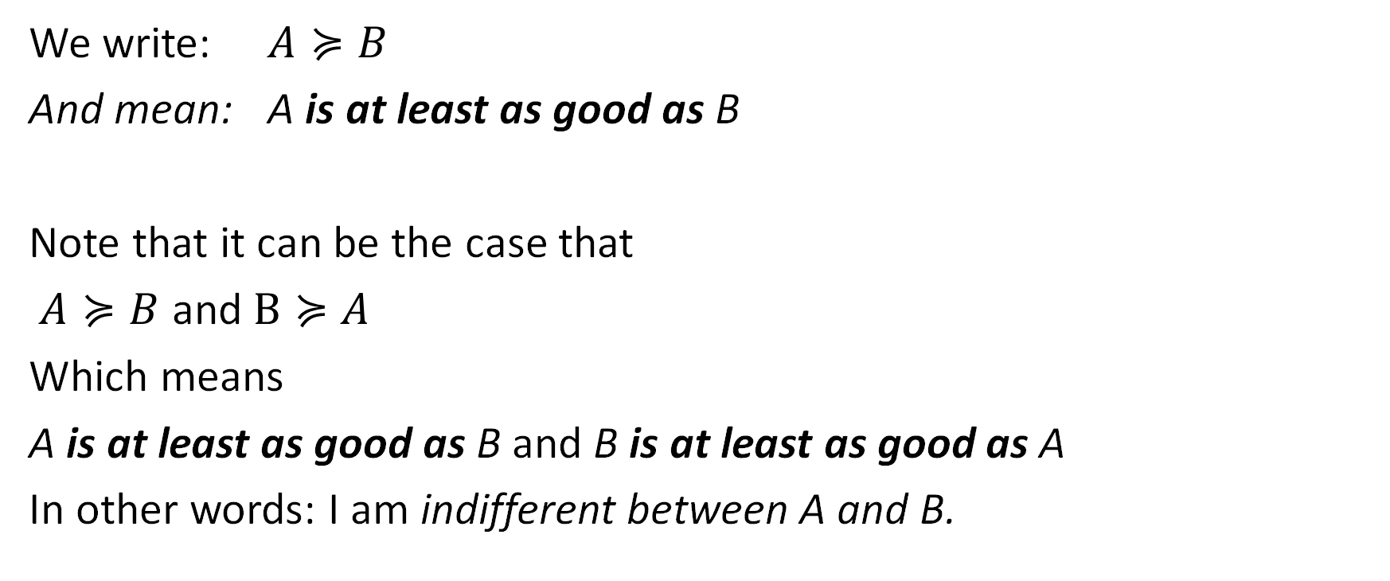
Preference Relation
We write: $A≽B$
And mean: A is at least as good as B
Note that it can be the case that
$A≽B$ and $B≽A$
Which means
A is at least as good as B and B is at least as good as A
In other words: I am indifferent between A and B.

Slide 10
Axioms
The theory of rational choice under certainty is an axiomatic theory.
Basic propositions that cannot be proven using the resources offered by theory, and which will simply have to be taken for granted.
The word comes from the Ancient Greek word ἀξίωμα (axíōma), meaning 'that which is thought worthy or fit' or 'that which commends itself as evident’
https://en.wikipedia.org/wiki/Axiom

Slide 11
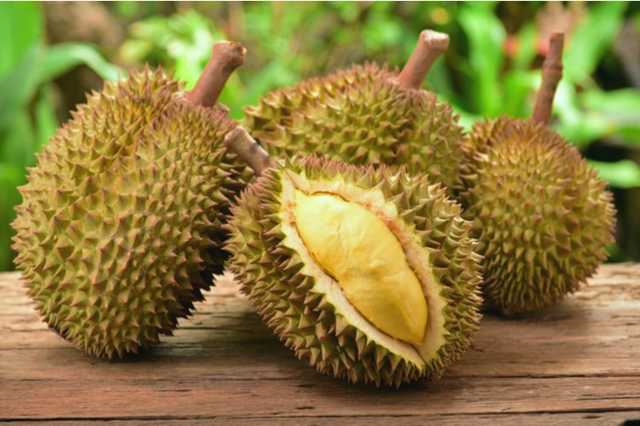
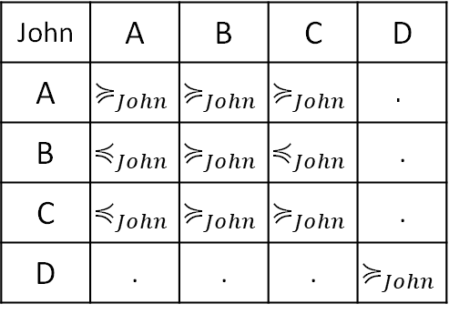
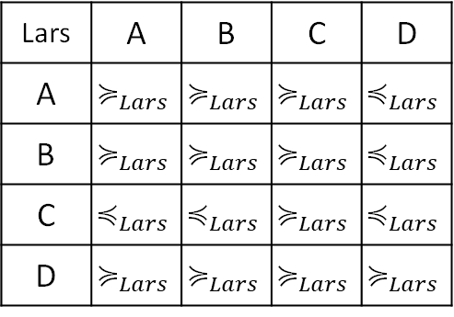
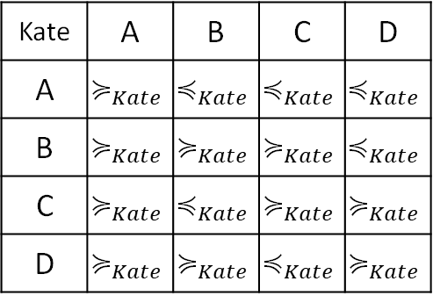
Preference Relation
Each person has different preferences. For example, considering preferences over Apples, Bananas, Cherries and Durian:
Kate | A | B | C | D
A | $$≽_{Kate}$$ | $$≼_{Kate}$$ | $$≼_{Kate}$$ | $$≼_{Kate}$$
B | $$≽_{Kate}$$ | $$≽_{Kate}$$ | $$≽_{Kate}$$ | $$≼_{Kate}$$
C | $$≽_{Kate}$$ | $$≼_{Kate}$$ | $$≽_{Kate}$$ | $$≽_{Kate}$$
D | $$≽_{Kate}$$ | $$≽_{Kate}$$ | $$≼_{Kate}$$ | $$≽_{Kate}$$
Lars | A | B | C | D
A | $$≽_{Lars}$$ | $$≽_{Lars}$$ | $$≽_{Lars}$$ | $$≼_{Lars}$$
B | $$≽_{Lars}$$ | $$≽_{Lars}$$ | $$≽_{Lars}$$ | $$≼_{Lars}$$
C | $$≼_{Lars}$$ | $$≼_{Lars}$$ | $$≽_{Lars}$$ | $$≼_{Lars}$$
D | $$≽_{Lars}$$ | $$≽_{Lars}$$ | $$≽_{Lars}$$ | $$≽_{Lars}$$
John | A | B | C | D
A | $$≽_{John}$$ | $$≽_{John}$$ | $$≽_{John}$$ | $$.$$
B | $$≼_{John}$$ | $$≽_{John}$$ | $$≼_{John}$$ | .
C | $$≼_{John}$$ | $$≽_{John}$$ | $$≽_{John}$$ | .
D | . | . | . | $$≽_{John}$$

Slide 12

Transitivity
A preference relation $≽$ is transitive if
$x≽y$
and
$y≽z$,
then
$$x≽z$$
($for all x, y, z)$

Slide 13
Transitivity
Kate | A | B | C | D
A | $$≽_{Kate}$$ | $$≼_{Kate}$$ | $$≼_{Kate}$$ | $$≼_{Kate}$$
B | $$≽_{Kate}$$ | $$≽_{Kate}$$ | $$≽_{Kate}$$ | $$≼_{Kate}$$
C | $$≽_{Kate}$$ | $$≼_{Kate}$$ | $$≽_{Kate}$$ | $$≽_{Kate}$$
D | $$≽_{Kate}$$ | $$≽_{Kate}$$ | $$≼_{Kate}$$ | $$≽_{Kate}$$
Lars | A | B | C | D
A | $$≽_{Lars}$$ | $$≽_{Lars}$$ | $$≽_{Lars}$$ | $$≼_{Lars}$$
B | $$≽_{Lars}$$ | $$≽_{Lars}$$ | $$≽_{Lars}$$ | $$≼_{Lars}$$
C | $$≼_{Lars}$$ | $$≼_{Lars}$$ | $$≽_{Lars}$$ | $$≼_{Lars}$$
D | $$≽_{Lars}$$ | $$≽_{Lars}$$ | $$≽_{Lars}$$ | $$≽_{Lars}$$
John | A | B | C | D
A | $$≽_{John}$$ | $$≽_{John}$$ | $$≽_{John}$$ | $$.$$
B | $$≼_{John}$$ | $$≽_{John}$$ | $$≼_{John}$$ | .
C | $$≼_{John}$$ | $$≽_{John}$$ | $$≽_{John}$$ | .
D | . | . | . | $$≽_{John}$$

Slide 14



Transitivity
Kate | A | B | C | D
A | $$≽_{Kate}$$ | $$≼_{Kate}$$ | $$≼_{Kate}$$ | $$≼_{Kate}$$
B | $$≽_{Kate}$$ | $$≽_{Kate}$$ | $$≽_{Kate}$$ | $$≼_{Kate}$$
C | $$≽_{Kate}$$ | $$≼_{Kate}$$ | $$≽_{Kate}$$ | $$≽_{Kate}$$
D | $$≽_{Kate}$$ | $$≽_{Kate}$$ | $$≼_{Kate}$$ | $$≽_{Kate}$$
Lars | A | B | C | D
A | $$≽_{Lars}$$ | $$≽_{Lars}$$ | $$≽_{Lars}$$ | $$≼_{Lars}$$
B | $$≽_{Lars}$$ | $$≽_{Lars}$$ | $$≽_{Lars}$$ | $$≼_{Lars}$$
C | $$≼_{Lars}$$ | $$≼_{Lars}$$ | $$≽_{Lars}$$ | $$≼_{Lars}$$
D | $$≽_{Lars}$$ | $$≽_{Lars}$$ | $$≽_{Lars}$$ | $$≽_{Lars}$$
John | A | B | C | D
A | $$≽_{John}$$ | $$≽_{John}$$ | $$≽_{John}$$ | $$.$$
B | $$≼_{John}$$ | $$≽_{John}$$ | $$≼_{John}$$ | .
C | $$≼_{John}$$ | $$≽_{John}$$ | $$≽_{John}$$ | .
D | . | . | . | $$≽_{John}$$
Not transitive
$${B≽}_{Kate}C$$
$${C≽}_{Kate}D$$
But
$${D≽}_{Kate}B$$
Transitive
For example:
$${D≽}_{Lars}A$$
$${A≽}_{Lars}B$$
$${D≽}_{Lars}B$$
(but we need to check all possibilities)
Transitive
For example:
$${A≽}_{Lars}B$$
$${B≽}_{Lars}C$$
$${A≽}_{Lars}C$$
(but we need to check all possibilities)

Slide 15

Completeness
A preference relation $≽$ is complete if
Either
$x≽y$
or
$y≽x$,
or both
($for all x, y, z)$

Slide 16
Completeness
Kate | A | B | C | D
A | $$≽_{Kate}$$ | $$≼_{Kate}$$ | $$≼_{Kate}$$ | $$≼_{Kate}$$
B | $$≽_{Kate}$$ | $$≽_{Kate}$$ | $$≽_{Kate}$$ | $$≼_{Kate}$$
C | $$≽_{Kate}$$ | $$≼_{Kate}$$ | $$≽_{Kate}$$ | $$≽_{Kate}$$
D | $$≽_{Kate}$$ | $$≽_{Kate}$$ | $$≼_{Kate}$$ | $$≽_{Kate}$$
Lars | A | B | C | D
A | $$≽_{Lars}$$ | $$≽_{Lars}$$ | $$≽_{Lars}$$ | $$≼_{Lars}$$
B | $$≽_{Lars}$$ | $$≽_{Lars}$$ | $$≽_{Lars}$$ | $$≼_{Lars}$$
C | $$≼_{Lars}$$ | $$≼_{Lars}$$ | $$≽_{Lars}$$ | $$≼_{Lars}$$
D | $$≽_{Lars}$$ | $$≽_{Lars}$$ | $$≽_{Lars}$$ | $$≽_{Lars}$$
John | A | B | C | D
A | $$≽_{John}$$ | $$≽_{John}$$ | $$≽_{John}$$ | $$.$$
B | $$≼_{John}$$ | $$≽_{John}$$ | $$≼_{John}$$ | .
C | $$≼_{John}$$ | $$≽_{John}$$ | $$≽_{John}$$ | .
D | . | . | . | $$≽_{John}$$
Complete
Complete
Not Complete

Slide 17
Rational Preferences
A rational preference relation
is one that is
transitive and complete.

Slide 18

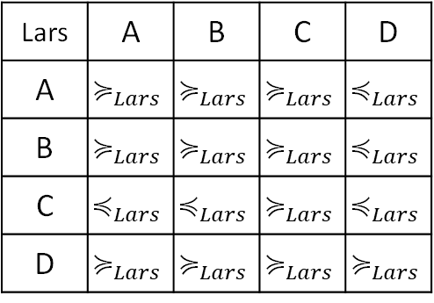

Preference orderings
If a preference relation is rational (transitive & complete), then we can construct a unique and acyclical preference order:
Lars | A | B | C | D
A | $$≽_{Lars}$$ | $$≽_{Lars}$$ | $$≽_{Lars}$$ | $$≼_{Lars}$$
B | $$≽_{Lars}$$ | $$≽_{Lars}$$ | $$≽_{Lars}$$ | $$≼_{Lars}$$
C | $$≼_{Lars}$$ | $$≼_{Lars}$$ | $$≽_{Lars}$$ | $$≼_{Lars}$$
D | $$≽_{Lars}$$ | $$≽_{Lars}$$ | $$≽_{Lars}$$ | $$≽_{Lars}$$
D
$$≻$$
A $\sim$ B
$$≻$$
C

Slide 19
Preference orderings with infinite alternatives
In many practical situations we want to consider an infinite number of alternatives: e.g. When shopping for fruits the question is not necessarily “Apples or Oranges”, but “How many apples and how many oranges?”
Infinite combinations exist!
For this we can think in terms of bundles of goods.
We can represent Preference Orderings for bundles using Indifference Curves

Slide 20
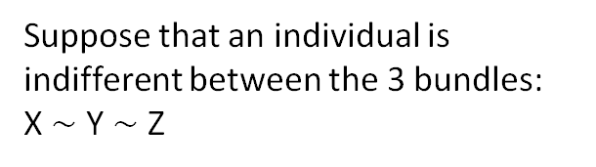
Indifference Curves
Suppose that an individual is indifferent between the 3 bundles:
X $\sim$ Y $\sim$ Z
Bananas (kg)
3
X
2
Y
Z
1
1
2
3
Apples (kg)

Slide 21

Indifference Curves
Suppose that an individual is indifferent between the 3 bundles:
X $\sim$ Y $\sim$ Z
One can probably find (infinite) other bundles, inbetween, for which that person is also indifferent.
All these together form an indifference curve.
Bananas (kg)
3
X
2
Y
Z
1
1
2
3
Apples (kg)

Slide 22
Indifference Curves
Bananas (kg)
3
M
2
L
1
K
1
2
3
Apples (kg)

Slide 23
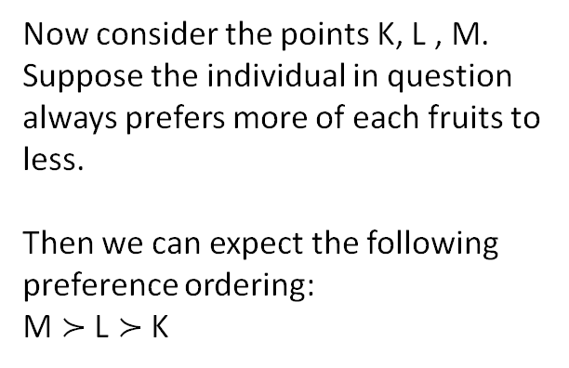
Indifference Curves
Now consider the points K, L , M.
Suppose the individual in question always prefers more of each fruits to less.
Then we can expect the following preference ordering:
M $≻$ L $≻$ K
Bananas (kg)
3
M
2
L
1
K
1
2
3
Apples (kg)

Slide 24
Indifference Curves
But each of these points will also lie on a separate indifference curve.
Given the preference ordering of these points, It must also be the case that any point that is on an indifference curve further up and/or to the right, must be “better than” any point on a curve further down and to the left.
Bananas (kg)
3
M
2
L
1
K
1
2
3
Apples (kg)

Slide 25
Remember:
Rational Choice Theory has two main elements:
Preferences: what does a person like.
Menus/budget sets: what can a person choose from.
The theory makes assumptions about preferences and how a person makes a choices from the available alternatives given their preferences.

Slide 26
Menus or choice sets
A Menu (or Choice Set) is a set of options from which a person has to choose exactly one:
Items are mutually exclusive: you can choose at most one.
The set is exhaustive: you must choose at least one.
Example: A restaurant offers two appetizers (soup & salad) and two mains (chicken & beef), and you must choose one appetizer and one main. Then your choice set is:
C = {soup-chicken, soup-beef, salad-chicken, salad-beef}
What is the choice set if you can choose to eat an appetizer only, a main only, or nothing at all?

Slide 27
Bundles and the Budget Line
In economics we think that what is available to you depends on what you can afford: i.e. your budget and the prices of goods.
Example: suppose you have $6 in your pocket, apples cost $2/kg and bananas cost $3/kg.
Bananas (kg)
Bundle available if you spend all your money on bananas.
2
Bundle available if you spend all your money on apples.
3
Apples (kg)

Slide 28
Bundles and the Budget Line
In economics we think that what is available to you depends on what you can afford: i.e. your budget and the prices of goods.
Example: suppose you have $6 in your pocket, apples cost $2/kg and bananas cost $3/kg.
Bananas (kg)
2
All other bundles that are available if you spend all your money on bundles of Apples and Bananas.
This is called the Budget Line.
3
Apples (kg)

Slide 29
Bundles and the Budget Line
In economics we think that what is available to you depends on what you can afford: i.e. your budget and the prices of goods.
Example: suppose you have $6 in your pocket, apples cost $2/kg and bananas cost $3/kg.
Bananas (kg)
2
All other bundles that are available if you do not spend all of your money.
This is called the Budget Set.
3
Apples (kg)

Slide 30


Choice under Certainty
Suppose Lars is in a friend’s house in Thailand and is offered a choice between Durian, Bananas or Cherries. What do you expect him to choose?
Now suppose the same happens at a friend’s house in Nicosia, So Durian is not available, but there are Apples, Bananas and Cherries. What do you expect him to choose?
Finally, suppose that his friend in Nicosia tells him that he made a mistake and there are no Bananas either, only Apples and Cherries. What do you expect him to choose?
Lars’ Preference Order
Durian
$$≻$$
Apple $\sim$ Banana
$$≻$$
Cherry

Slide 31
Rational choice
For a person to be rational (or to make rational choices) means:
To have a rational preference ordering
Faced with a menu of choices / a budget, the person chooses the most preffered item, or (in case of ties) one of the most preferred items.

Slide 32
Rational choice over bundles
Bananas (kg)
Given the person’s preferences (represented by the indifference curves) and budget set, this is the rational choice.
It is the most highly preferred bundle in the budget set.
3
2
1
1
2
3
Apples (kg)

Slide 33
Rational choice theory
To better understand the theory, it is important to understand what the theory DOES NOT say:
It does not say why people prefer certain things.
It does not say why people choose the most preferred item.
It does not say people are selfish.
Rational people cannot have preferences that are intransitive or incomplete, and they cannot make choices that fail to reflect those preferences. That’s all…

Slide 34

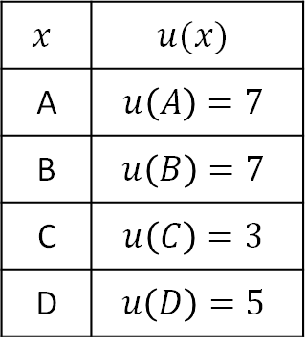
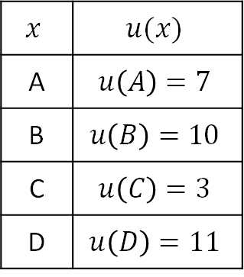
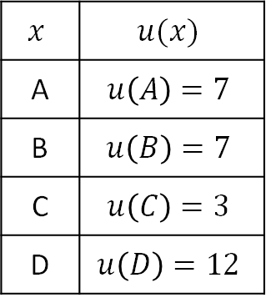
Utility
$$x$$ | $$u(x)$$
A | $$u\left(A\right)=7$$
B | $$u\left(B\right)=7$$
C | $$u\left(C\right)=3$$
D | $$u\left(D\right)=5$$
Lars’ Preference Order
$$x$$ | $$u(x)$$
A | $$u\left(A\right)=7$$
B | $$u\left(B\right)=7$$
C | $$u\left(C\right)=3$$
D | $$u\left(D\right)=12$$
D
Which of these functions could best represent Lars’ enjoyment of the different fruits?
$$≻$$
A $\sim$ B
$$≻$$
$$x$$ | $$u(x)$$
A | $$u\left(A\right)=7$$
B | $$u\left(B\right)=10$$
C | $$u\left(C\right)=3$$
D | $$u\left(D\right)=11$$
C

Slide 35
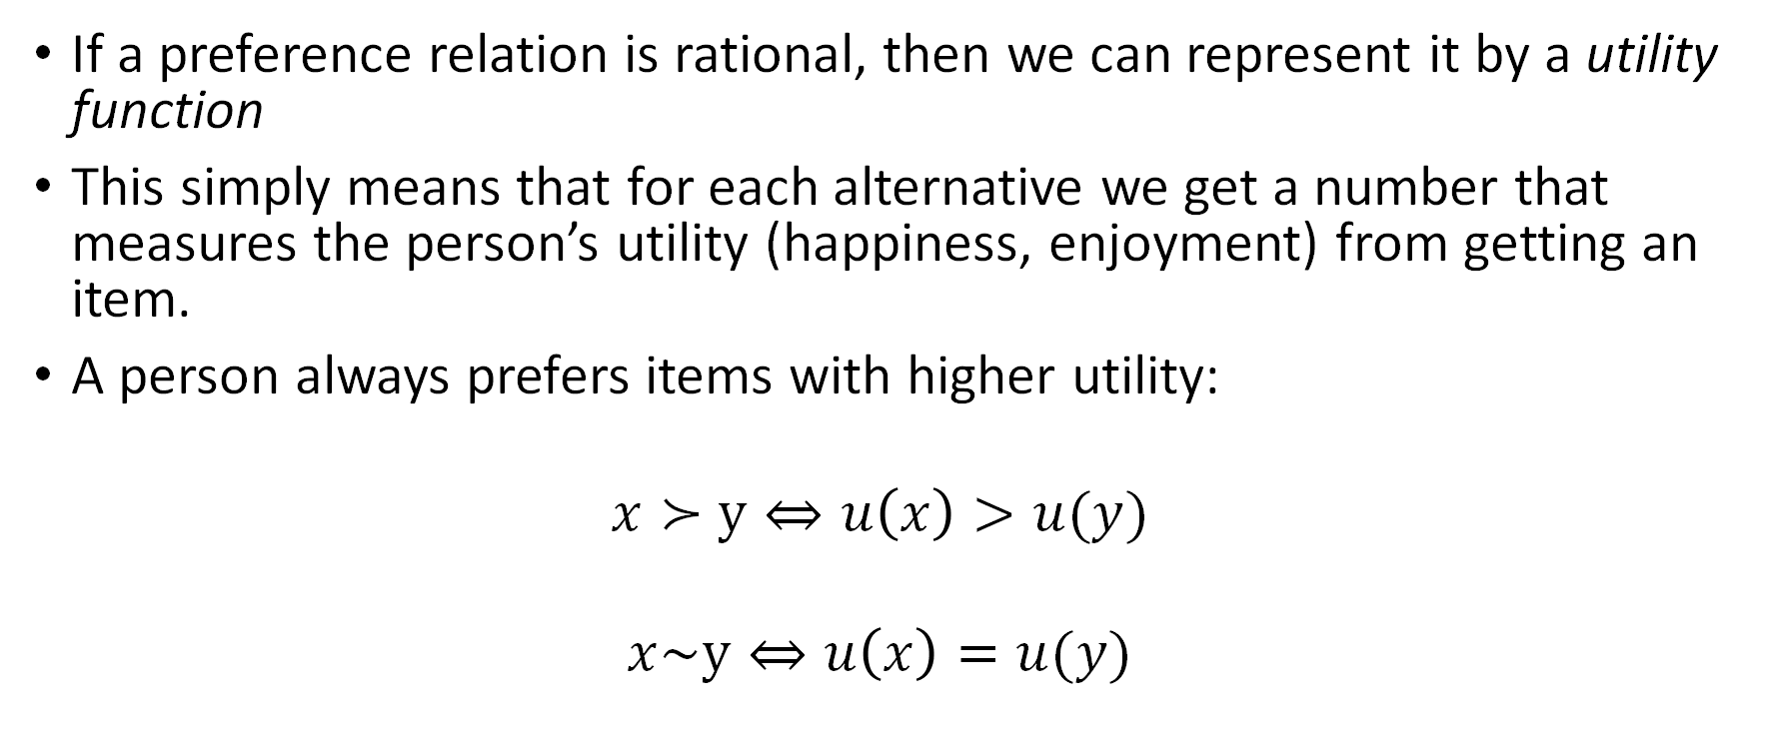
Utility
If a preference relation is rational, then we can represent it by a utility function
This simply means that for each alternative we get a number that measures the person’s utility (happiness, enjoyment) from getting an item.
A person always prefers items with higher utility:
$$x≻y⇔u\left(x\right)>u(y)$$
$$x\sim y⇔u\left(x\right)=u(y)$$

Slide 36
Utility maximization
In terms of utility, Rational choice implies:
To have a rational preference ordering
=> To have a utility function
Faced with a menu of choices / a budget, the person chooses the most preffered item, or (in case of ties) one of the most preferred items.
=> To maximize utility

Slide 37



Utility maximization
Bananas (kg)
3
2
1
$U_{3}=$ 7
$U_{2}=$ 5
$U_{1}=$ 2
1
2
3
Apples (kg)

Slide 38
Discussion
Is this a plausible theory of human behavior under conditions of certainty?
Descriptive: Do people’s actual choices reflect a rational preference ordering?
Normative: Should people try to maximize their utility?

Slide 39
Review exercises
Represent the following sets of indifference curves graphically.
Suppose that an apple for you is always as good as two bananas.
Suppose that one apple is always as good, as far as you are concerned, as a banana.
Suppose that you do not care for tea without milk or for milk without tea. However, every time you have two units of tea and one unit of milk, you can make yourself a cup of tea with milk. You love tea with milk, and the more the better, as far as you are concerned.

Slide 40
Review exercises
Represent the following sets of indifference curves graphically.
Suppose that an apple for you is always as good as two bananas.
Bananas
4
3
2
1
1
2
3
4
Apples

Slide 41
Review exercises
Represent the following sets of indifference curves graphically.
Suppose that an apple for you is always as good as two bananas.
Bananas
4
3
2
1
1
2
3
4
Apples

Slide 42
Review exercises
Represent the following sets of indifference curves graphically.
Suppose that one apple is always as good, as far as you are concerned, as a banana.
Bananas
4
3
2
1
1
2
3
4
Apples

Slide 43
Review exercises
Represent the following sets of indifference curves graphically.
Suppose that one apple is always as good, as far as you are concerned, as a banana.
Bananas
4
3
2
1
1
2
3
4
Apples

Slide 44
Review exercises
Represent the following sets of indifference curves graphically.
Suppose that you do not care for tea without milk or for milk without tea. However, every time you have two units of tea and one unit of milk, you can make yourself a cup of tea with milk. You love tea with milk, and the more the better, as far as you are concerned.
Milk
4
3
2
1
1
2
3
4
5
6
7
Tea

Slide 45
Review exercises
Represent the following sets of indifference curves graphically.
Suppose that you do not care for tea without milk or for milk without tea. However, every time you have two units of tea and one unit of milk, you can make yourself a cup of tea with milk. You love tea with milk, and the more the better, as far as you are concerned.
Milk
4
3
2
1
1
2
3
4
5
6
7
Tea

Slide 46
Review exercises
Which of these two graphs is more likely to represent an indifference curve?
Juice
Juice
4
4
3
3
2
2
1
1
1
2
3
4
5
6
7
Coffee
1
2
3
4
5
6
7
Coffee

Slide 47
Review exercises
Recall that the graph below represents the budget set when:
Your budget is $6, apples cost $2/kg and bananas cost $3/kg.
Bananas (kg)
2
3
Apples (kg)

Slide 48
Review exercises
What is the budget set when you have the same budget but now the price of bananas drops to $1/kg?

Slide 49
Review exercises
What is the budget set when you have the same budget but now the price of bananas drops to $1/kg?
6
Bananas (kg)
2
3
Apples (kg)

Slide 50
Review exercises
What is the budget set when your budget is $12, apples cost $2/kg, the first banana costs $4 and every subsequent banana costs $2?

Slide 51
Review exercises
Explain why each of the characters below is irrational according to rational choice theory.
An economics professor finds that he prefers a $10 bottle of wine to a $8 bottle, a $12 bottle to a $10 bottle, and so on; yet he does not prefer a $200 bottle to a $8 bottle.
Buridan’s donkey paradox: a donkey is very hungry and finds itself exactly midway between a stack of hay and pail of water. Unable to decide which is better, the animal starves to death.

